Slide 1
Analytical CRM Development for a Bank

Slide 2
Problem Statement :
The bank aims to reduce customer churn, improve service delivery, and enhance customer satisfaction through the effective CRM straggies
Objective and importance of CRM:
Reduce the customer churn: Identify factor contributing to customer attrition.
Improve Service Delivery : Enhance the quality and efficiency of service offered to customers based on their preference and behavior.
Enhance Customer Satisfaction: Understand customer need and preference to deliver personalized experience that help them to stay long with bank.
Importance
Retaining existing customer.
Enhancing customer satisfaction lead to increase customer loyalality and lifetime value.
Understanding customer behavior.

Slide 3
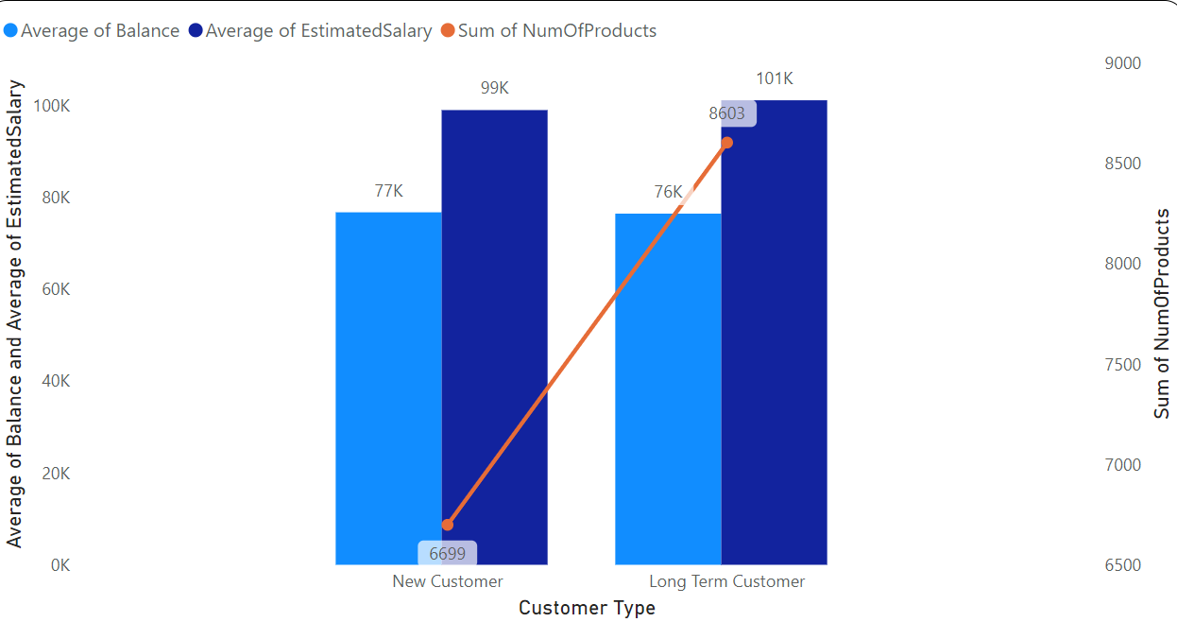
Customer Behavior Analysis :
Spending Habit:
Long-Term Customers: customers (tenure greater than 4 year) has high spending habit compared to new customers (tenure equals to 3 or 4 year)
As the long term customers have higher average estimated salary than the new customers but even they maintain their average balance in account equals to average balance account of new customers

Slide 4
Customer Loyalty:
The customer who stay more with the bank and has maximum tenure (greater than 4)
The Customer who have more average balance in their account are the loyal customer as they have faith in the bank.
The customer who use maximum of the services provided by bank are the loyal customers.
These loyal customers have faith in bank and even show interest in new services if bank provide in future.

Slide 5
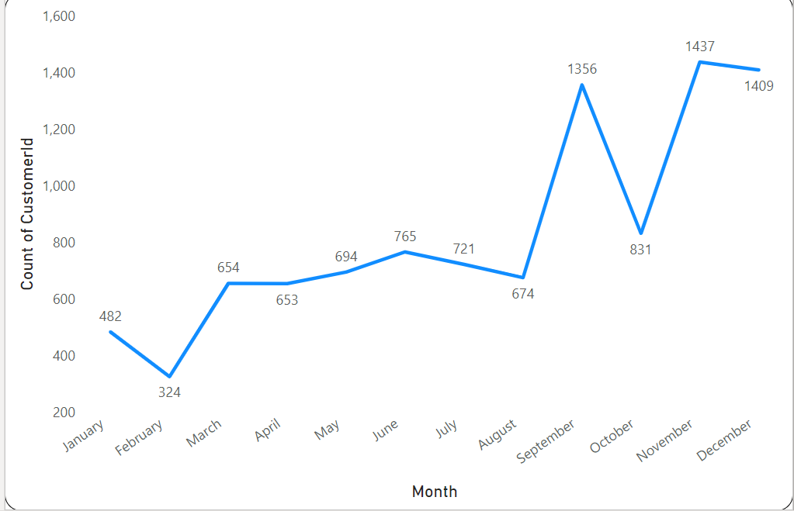
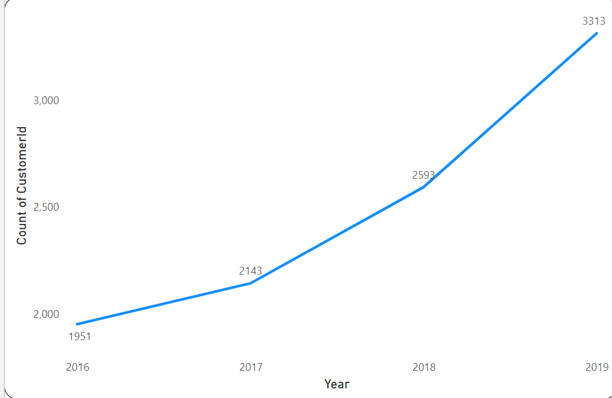
Customer Joining Pattern or Trend:
As we can see from above line chart that count of customer joining the bank increase with increase in year
As 2016 , 1951 customers who joined the bank
As in 2017 , 2143 customers joined the bank
As in 2018, 2593 customers joined the bank
As in 2019 , 3313 customers joined the bank

Slide 6
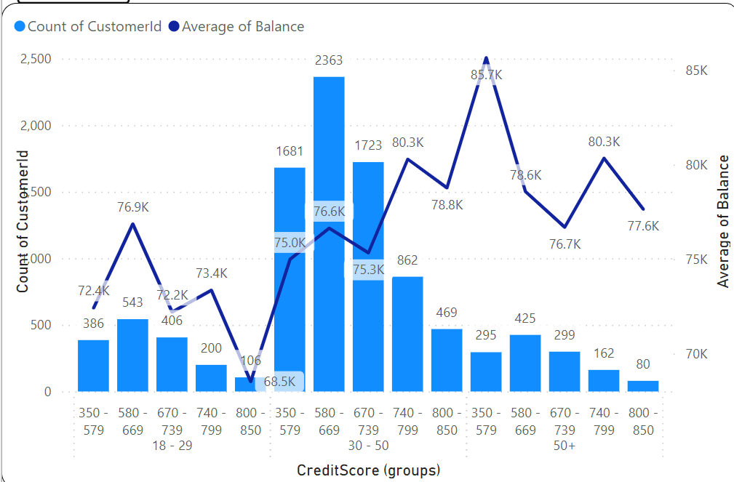
Predicting Customer Tenure
Lifetime (tenure) of the customers based on the Age Bracket, Credit Score, Average balance they are maintaining.
Here from the above gragh we can say that
Customer from age bracket 31 – 50 stay more with the bank

Slide 7
Age Bracket (18-29) customers just joined the bank and maintain very low average balance and even they have low credit score as they have just joined the bank.
As we move further from age group 30- 50 these are customers who have high tenure and stay long with bank as they have good credit score and even they maintain high average balance in their account.
As we move from 50+ age bracket these customer again decrease there credit score so they less tenure and stay less with bank even if they maintain high average balance in account.

Slide 8
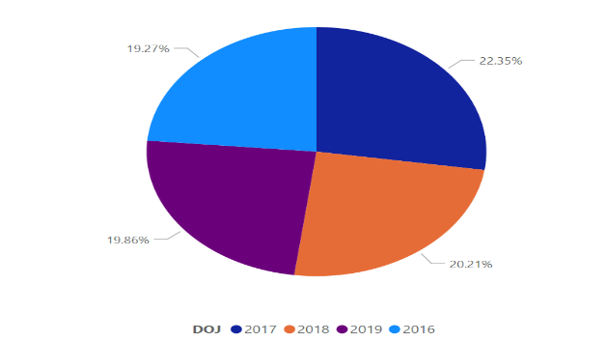
Key Factor Affecting customer churn
HasCrCard: Customer not having credit card
Tenure: New Customer having tenure of 3 or 4 year
EstimatedSalary: Customer with low average estimated salary.
NumOfProduct: Customer who are not using any of product or service provided by bank
Balance : Customer with zero balance are more likely to leave bank.
Churn Rate per Year
Churn rate for year 2016 : 19.27%
Churn rate for year 2017 : 22.35%
Churn rate for year 2018 : 20.21%
Churn rate for year 2019 : 19.86%
Overall Churn Rate : 20.37%
Bank has 10,000 customers out of which 2037 customers has left bank.

Slide 9
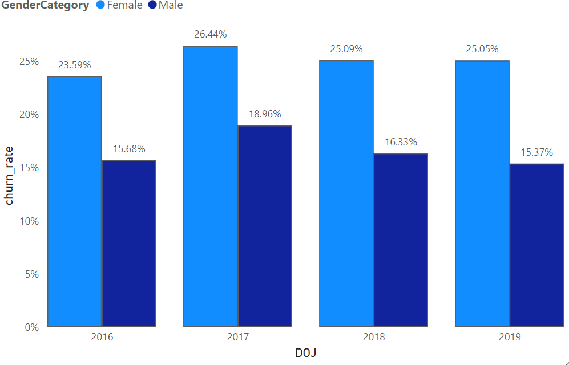
Gender wise Churn rate for most recent year
For the most recent year 2019
churn rate for male: 15.37%
churn rate for female: 25.05%
Churn rate for year 2018
churn rate for male: 16.33 %
churn rate for female: 25.09 %
Churn rate for year 2017
churn rate for male: 18.96%
churn rate for female: 26.44%
Churn rate for year 2016
churn rate for male: 15.68%
churn rate for female: 23.59%

Slide 10
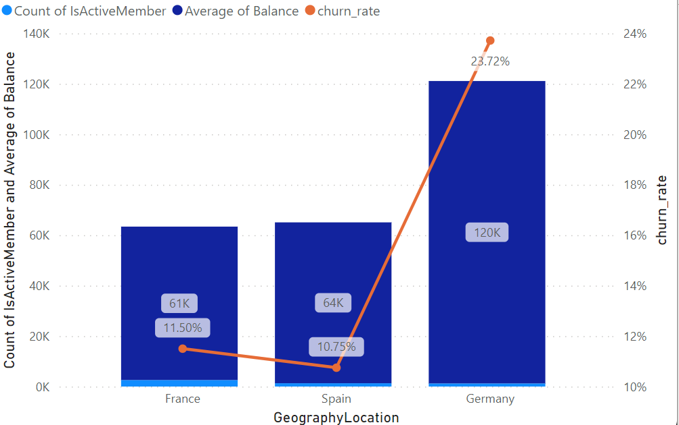
Demographic Analysis
Churn rate by geography
Germany has highest churn rate 23.72% and has lowest number of active accounts 1248 and has highest average balance of 120K.
France has second highest churn rate 11.50% and has highest number of active account 2591 and has lowest average balance of 61K.
Spain has lowest churn rate 10.75% and has second highest number of active account 1312 and has average balance of 64K

Slide 11
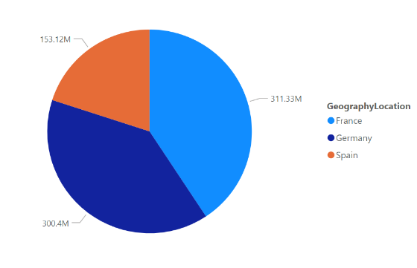
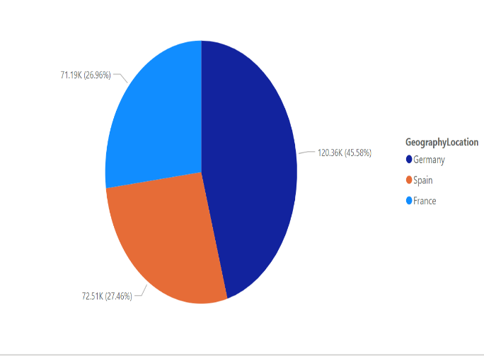
Distribution of account balance across different regions
France has highest account balance among all the
country which is 311Million
Germany has second highest account balance which
is 300million.
Spain has total account balance of 153.12million.
Ranking Location based on churn rate and balance.
As Germany is rank 1 as number of people who churn the bank is 814 and average balance is 120361.08
France is rank 2 as number of people who churn the bank is 810 and average balance is 71192.8
Spain is rank 3 as number of people who churn the bank is 413 and average balance is 72513.35

Slide 12
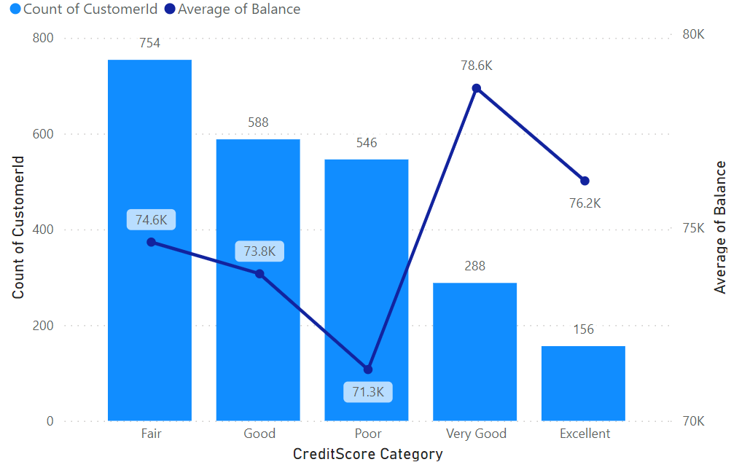
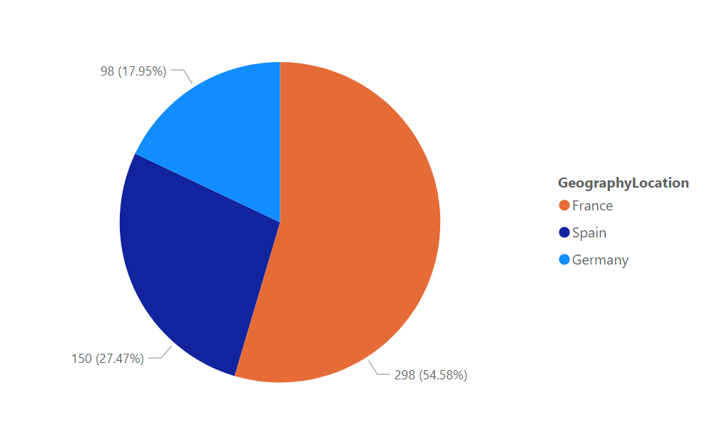
Location at Financial Risk
Customer that belongs to Poor credit score category(350-579) has high financial risk to the bank as they have lowest average balance 71.3K, and even they are non- card holder
546 customers belongs to poor credit score category who are with the bank
France has highest number of customer 298 who belong to Poor Credit score category,
So they customer of France with non-credit card and having 0 balance or having low average balance are finically risk to bank.

Slide 13
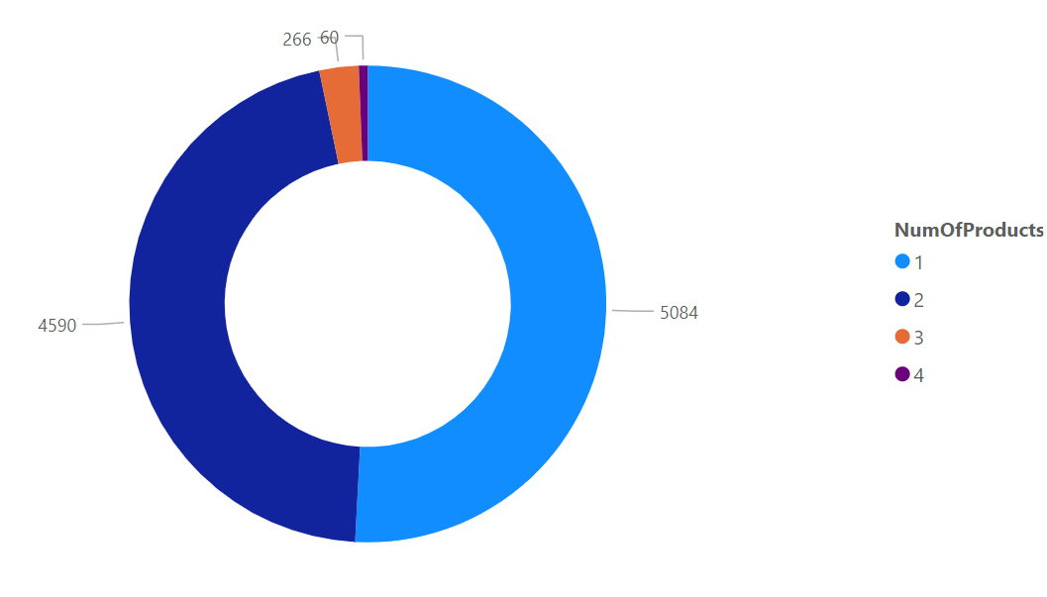
Product Affinity Analysis:
As from the analysis:
Product used by both type of customer who
exited bank and who are with bank.
NumOfProducts 1 has most commonly used
together among all NumOfProduct as
NumOfProducts 1 is used by 5084customer
NumOfProducts 2 is used by 4590 customers
NumOfProducts 3 is used by 266 customers
NumOfProducts 4 is used by 60 customers

Slide 14
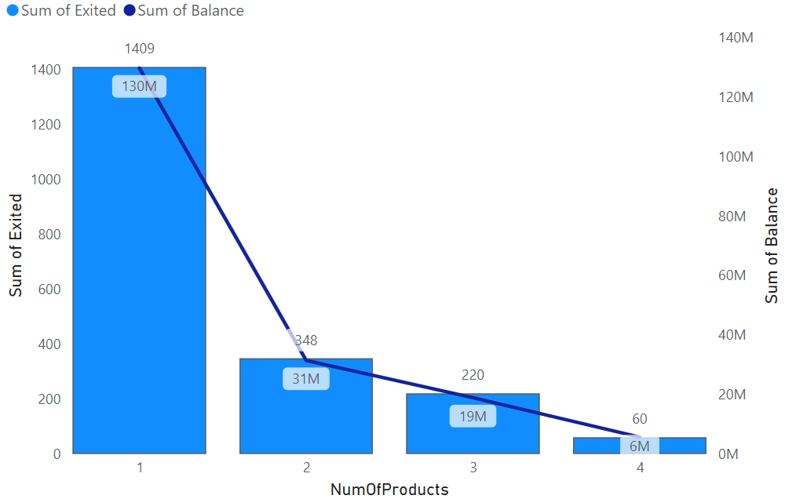
Product used by exited customers.
NumOfProduct 1 used by 1409 customers and they have total balance around 130 Million.
NumOfProduct 2 used by 348 exit customers and they have sum of balance around 31 million.
NumOfProduct 3 used by 220 exit customers and they have total balance around 19Million.
NumOfProduct 4 used by 60 exit customers and they have total balance around 6 million.
So we can say that product: NumOfproduct 1 is commonly used among all the product by exit customers.

Slide 15
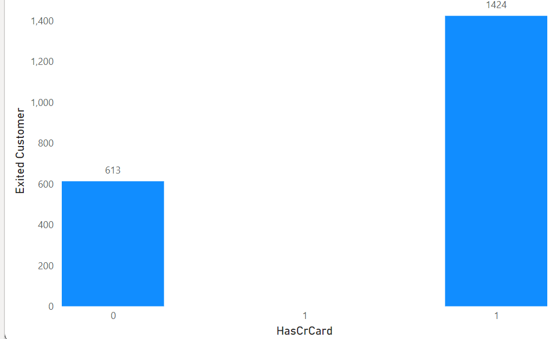
Customer Retention :
Conducting Marketing Campaign
Detailed data on marketing campaign spend on messages and through the channels.
Credit card must be offered to the customer who exited.
Bank should provide interactive offers to the customer on their services in the order to retain their customer back.
As we can see that customer having already card are also exited from the bank , such customer are provided extra offer on their services so that they can stay long with bank.

Slide 16
Cross selling Strategies:
1. Identifying Complementary Products: By understanding which bank products or services are frequently used together, banks can identify natural pairings or complementary offerings
2.Tailoring Product Bundles: Bundling related products together can make the offering more attractive to customers and increase the likelihood of cross-selling multiple products in a single transaction.
3.Personalized Recommendations: Banks can leverage product affinity insights to deliver personalized product recommendations to individual customers based on their banking behavior.
4.Cross-Selling Campaigns: Banks can design targeted cross-selling campaigns that highlight complementary products and services to specific customer segments.
5. Improving Customer Experience: Understanding product affinities can also help banks enhance the overall customer experience by offering seamless integration and interoperability between related products and services.

Slide 17
How to reduce churn rate
By providing Credit card to the customer having low credit score.
Understanding customer behavior
Increasing customer satisfaction
Increasing faith of customer with bank.
By providing more offer to customers related to their product service.
By increasing awareness of the product or service which bank providing by the messages, campaign

Slide 18
Thankyou

